Slide 1



Ameenah Salihu- Riby Dataset Interactive Dashboard
View in Power BI
Last data refresh:
19/01/2023 11:11:45 UTC
Downloaded at:
20/01/2023 06:55:16 UTC

Slide 2
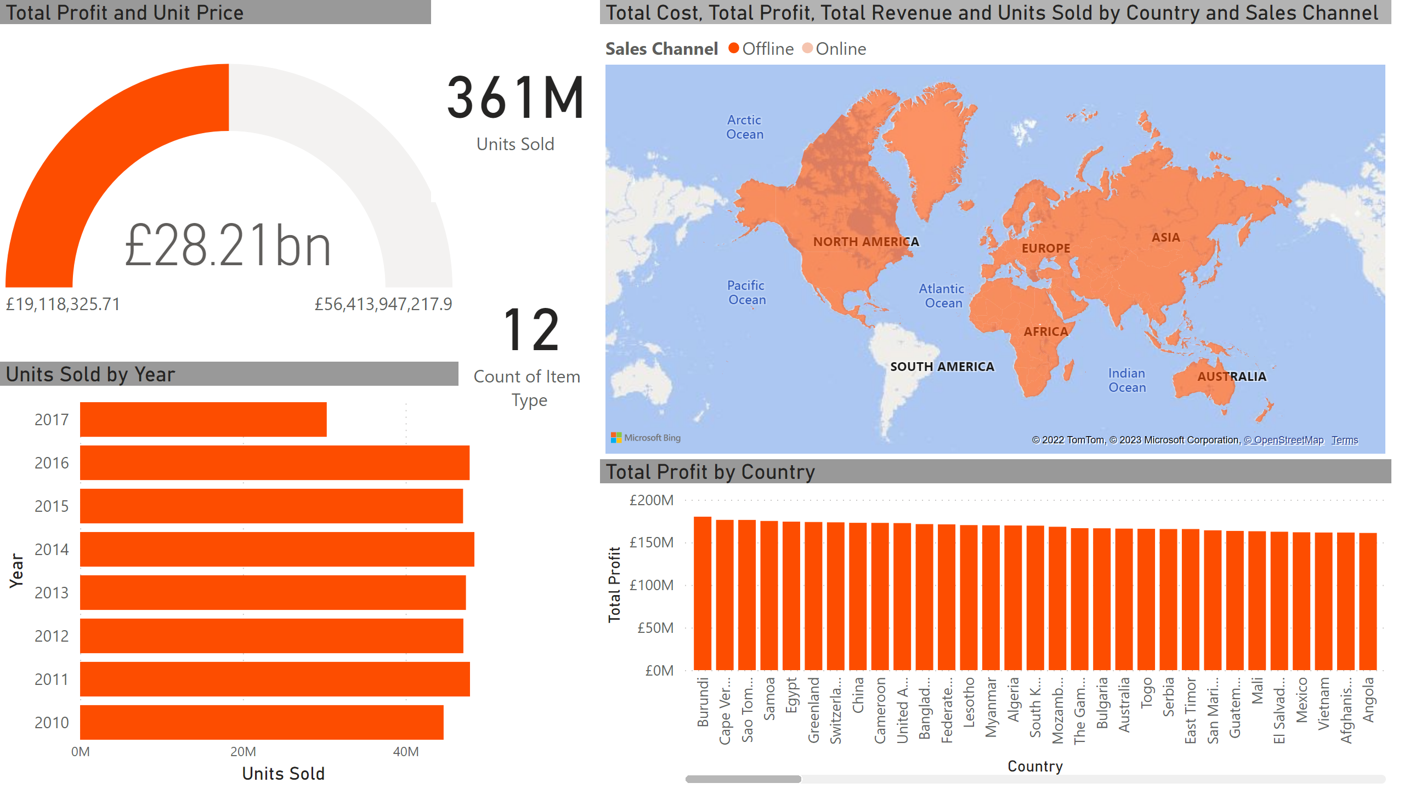
Data Overview
Notes:
filledMap
No alt text provided
columnChart
No alt text provided
gauge
No alt text provided
barChart
No alt text provided
card
No alt text provided
card
No alt text provided

Slide 3
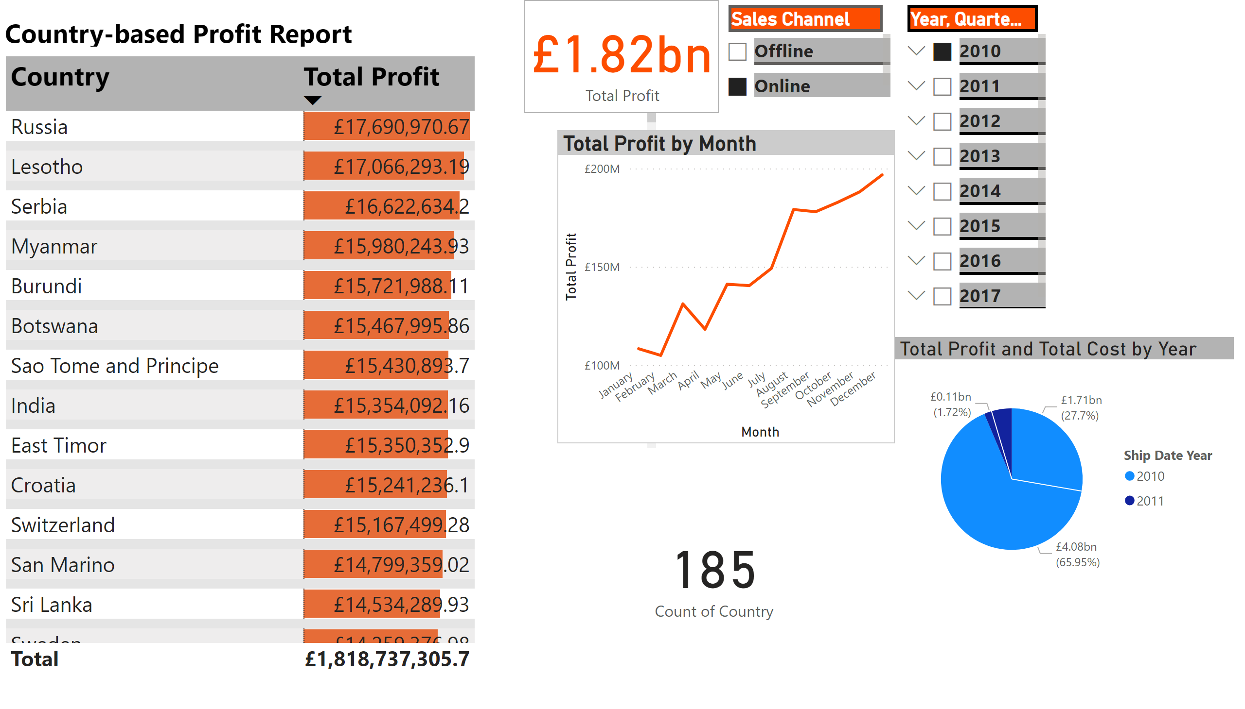
Country-based Profit Report
Notes:
tableEx
No alt text provided
slicer
No alt text provided
slicer
No alt text provided
textbox
No alt text provided
lineChart
No alt text provided
card
No alt text provided
card
No alt text provided
pieChart
No alt text provided

Slide 4
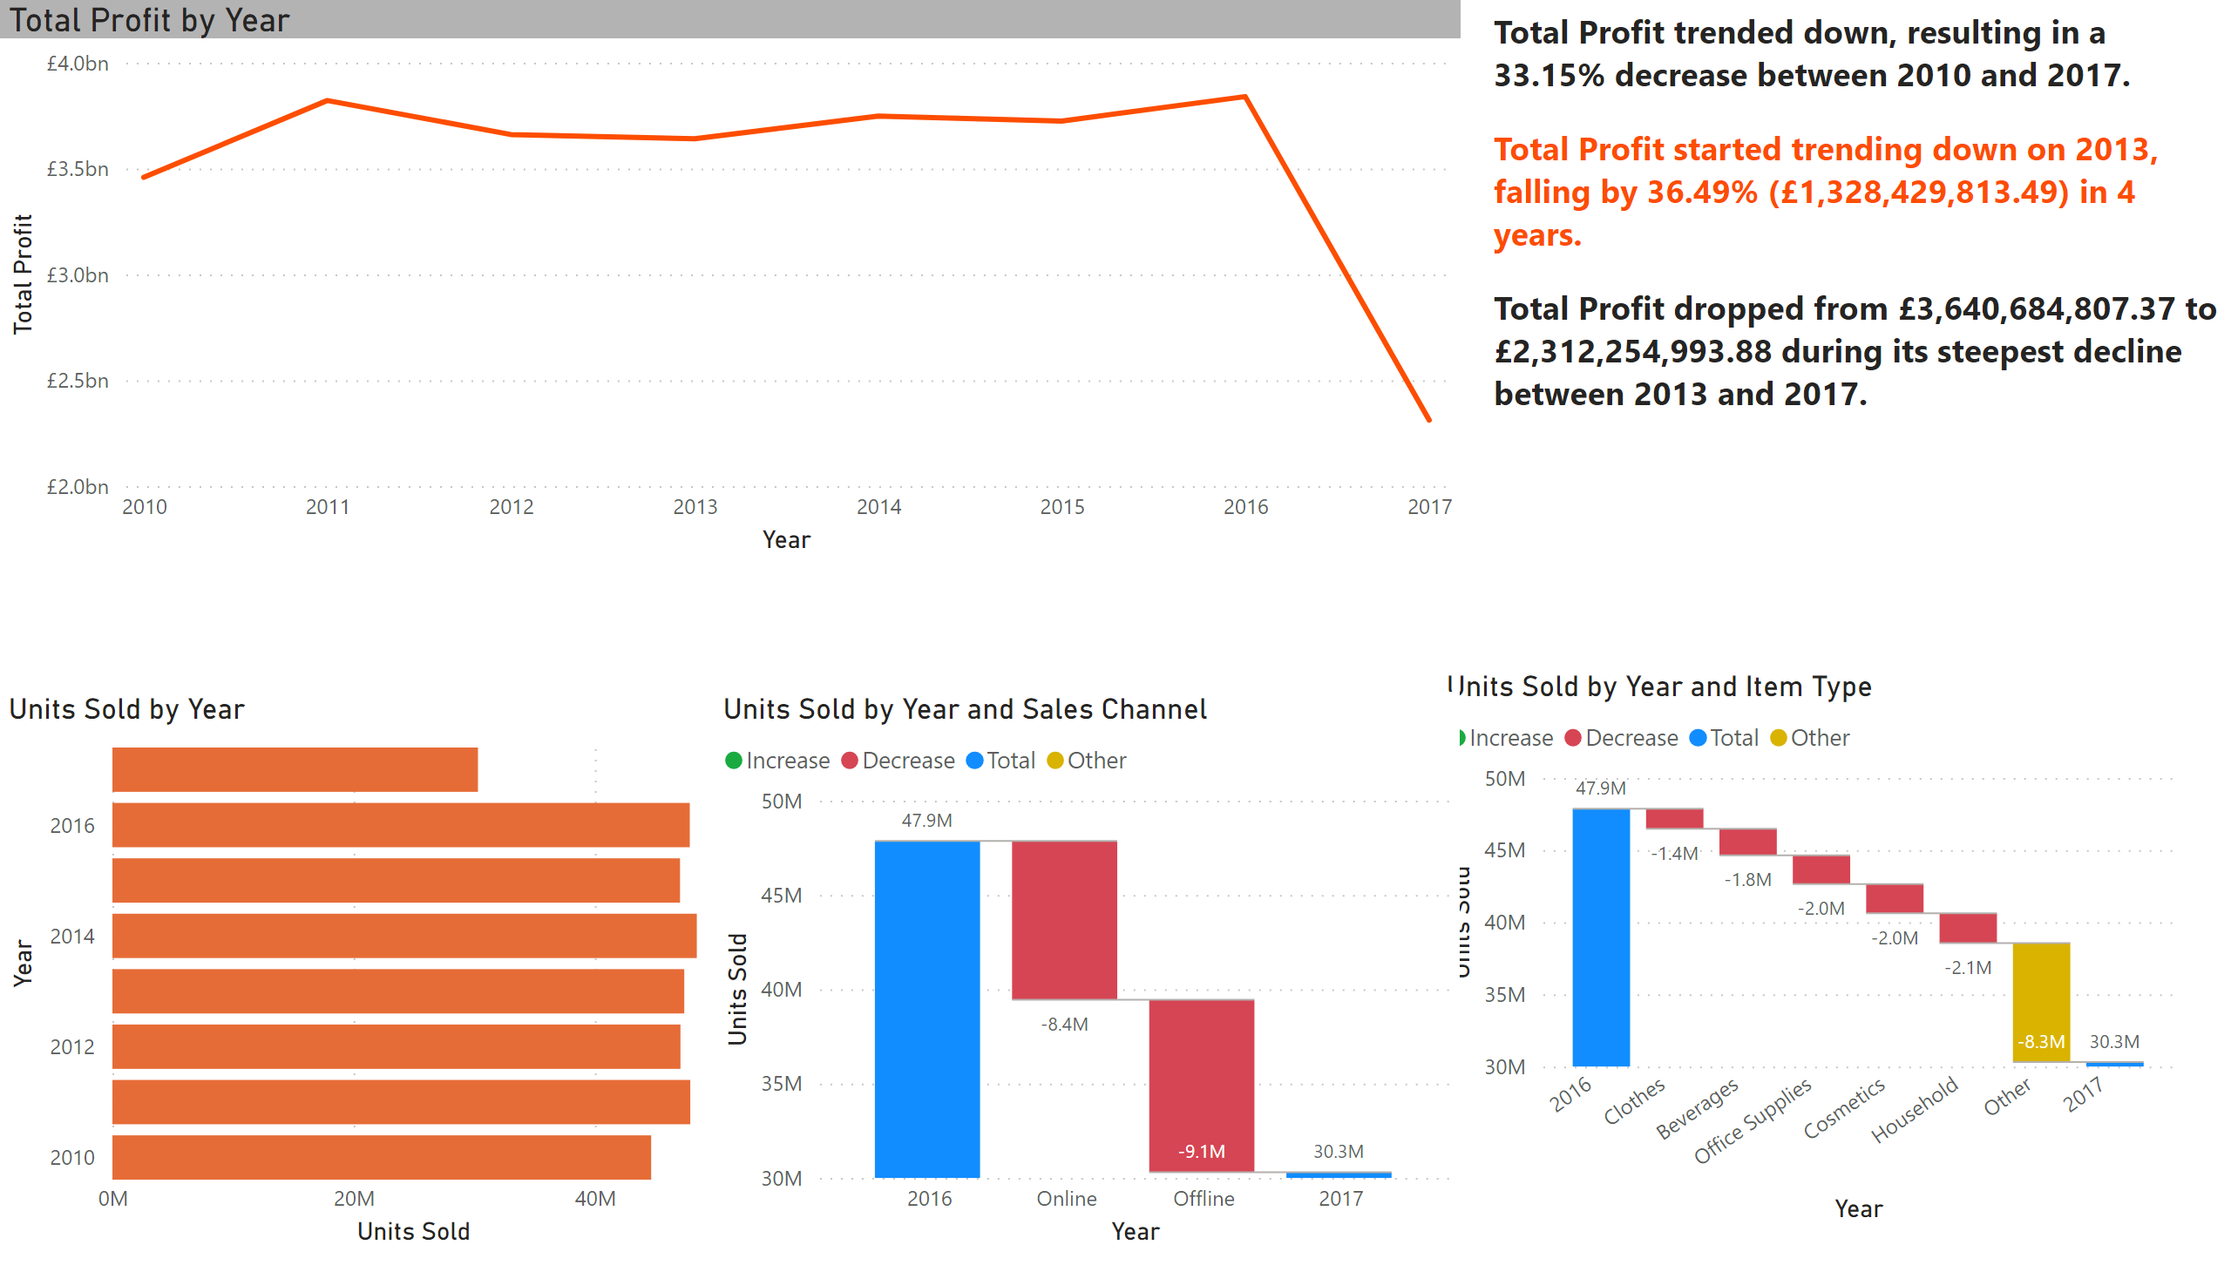
Customer Transaction Analysis
Notes:
barChart
No alt text provided
waterfallChart
No alt text provided
waterfallChart
No alt text provided
textbox
No alt text provided
lineChart
No alt text provided

Slide 5
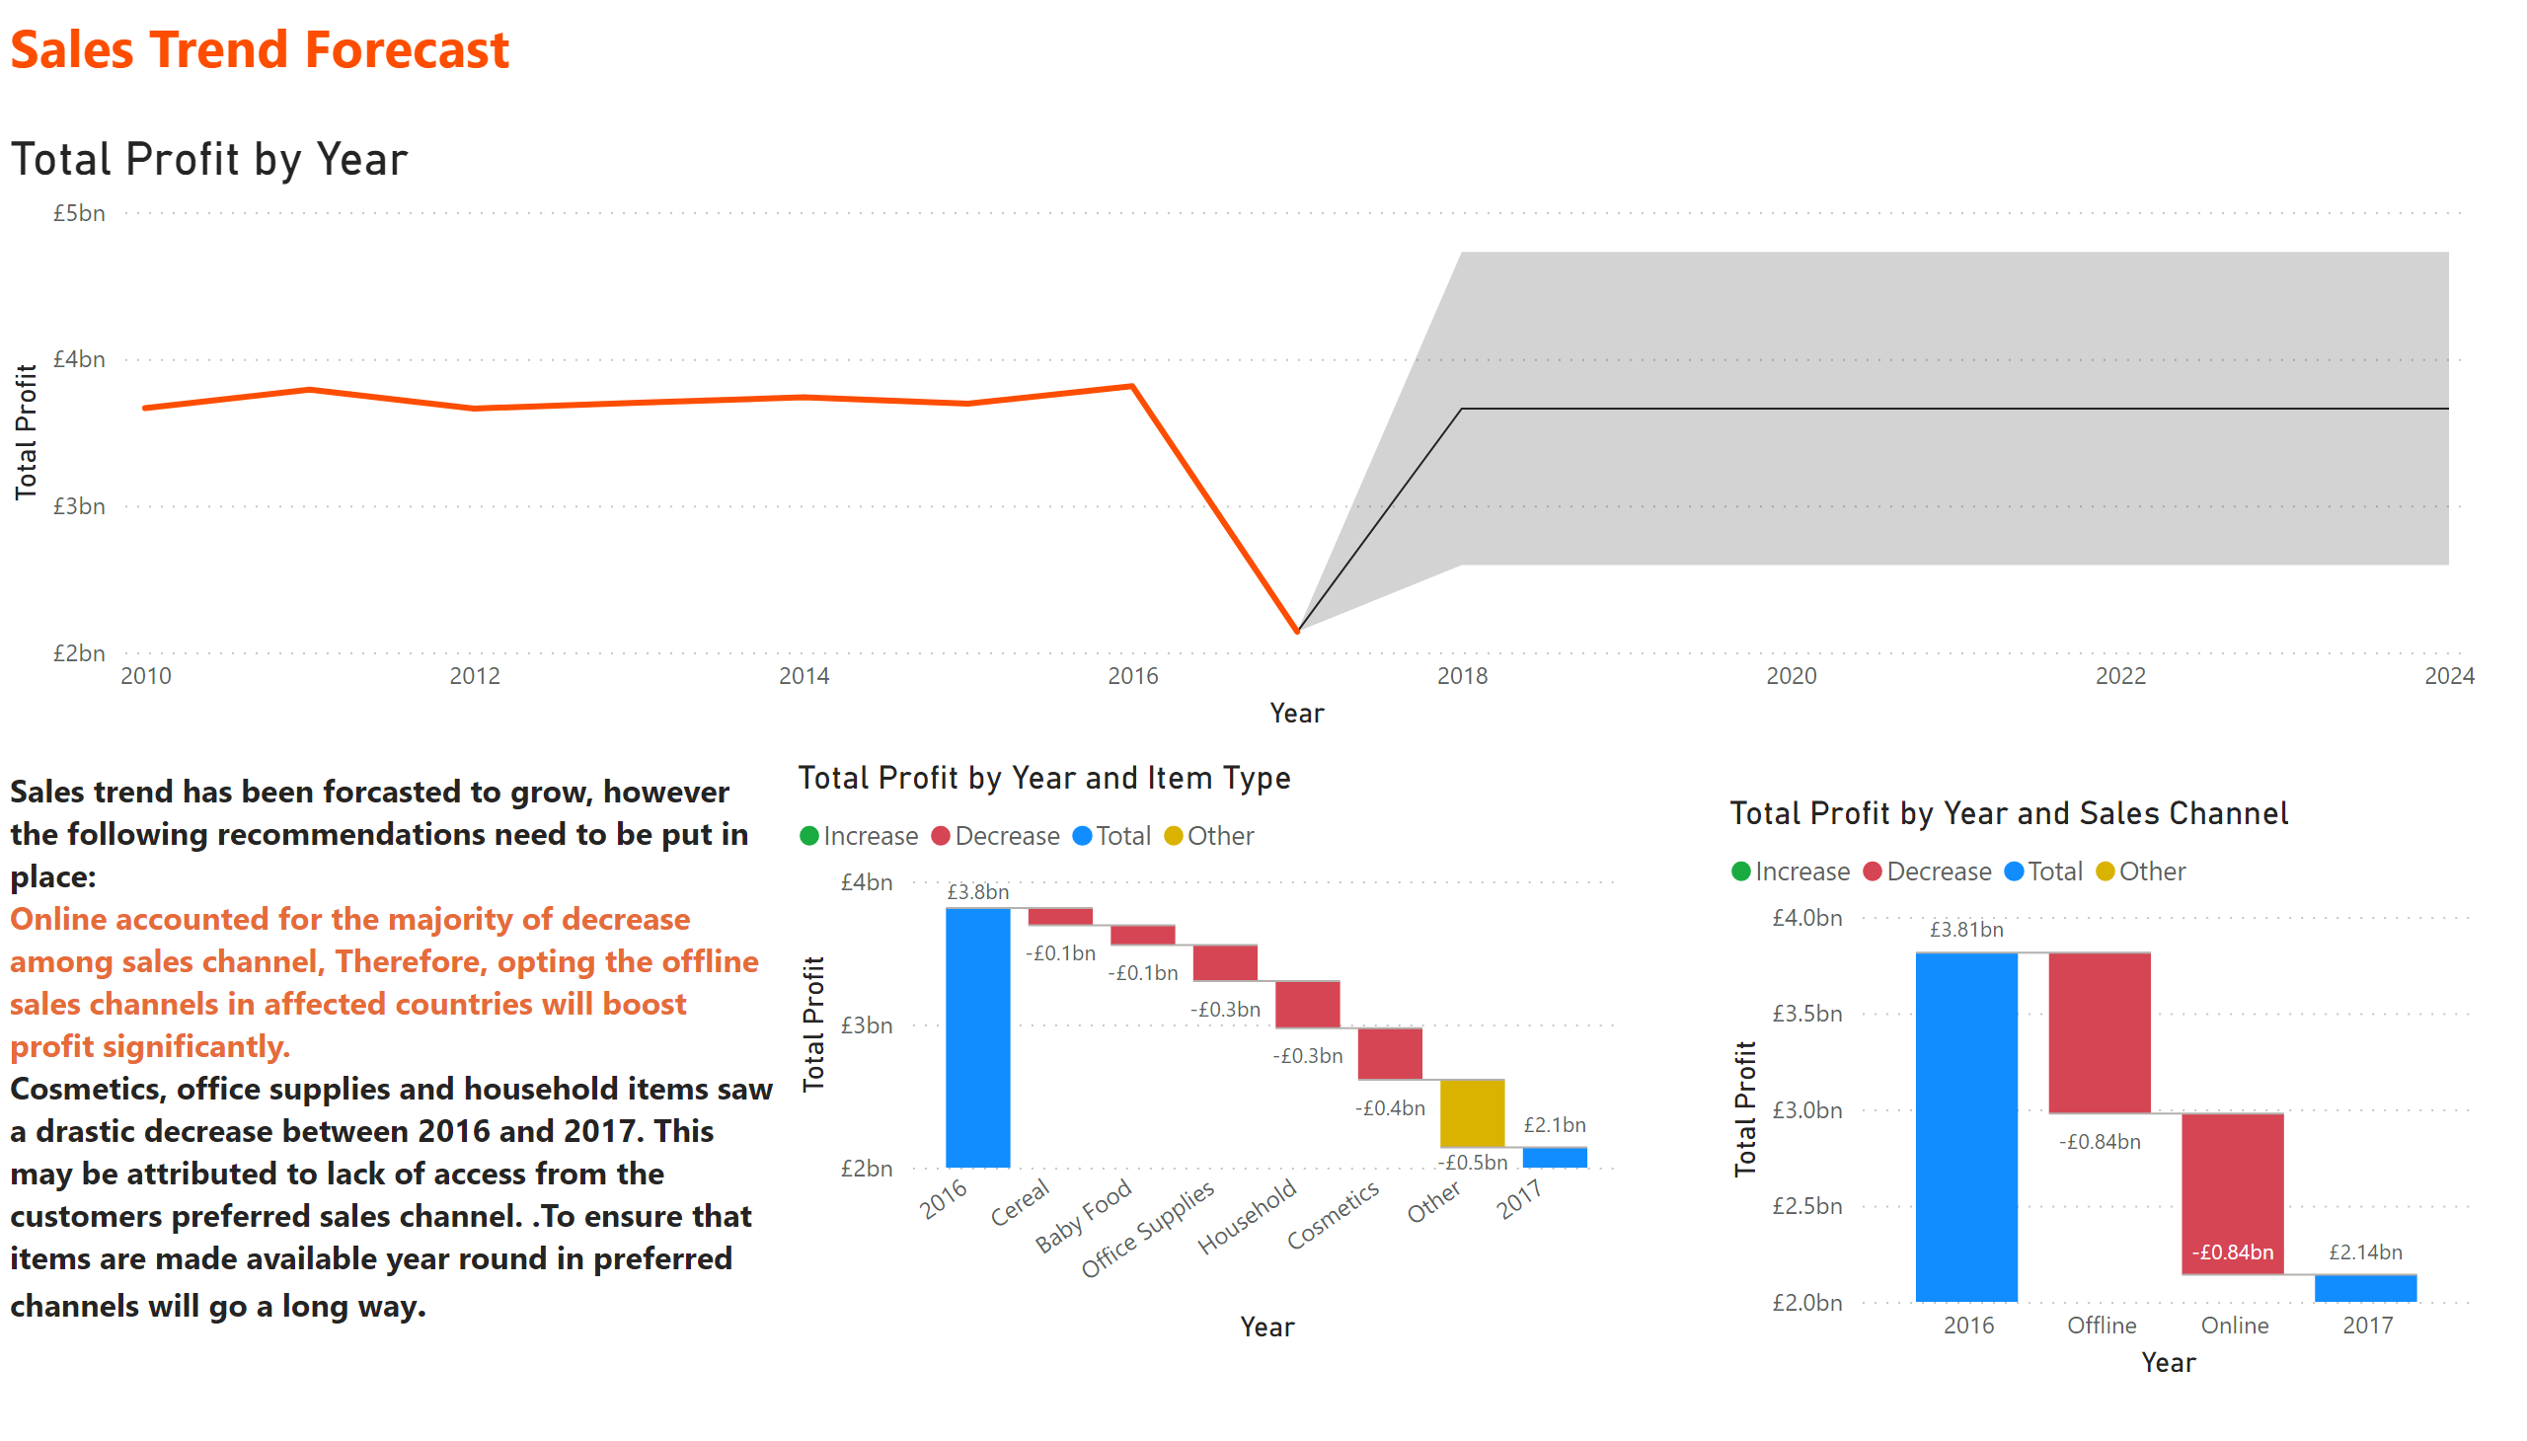
Sales Trend Forecast
Notes:
lineChart
No alt text provided
textbox
No alt text provided
textbox
No alt text provided
waterfallChart
No alt text provided
waterfallChart
No alt text provided

Slide 6
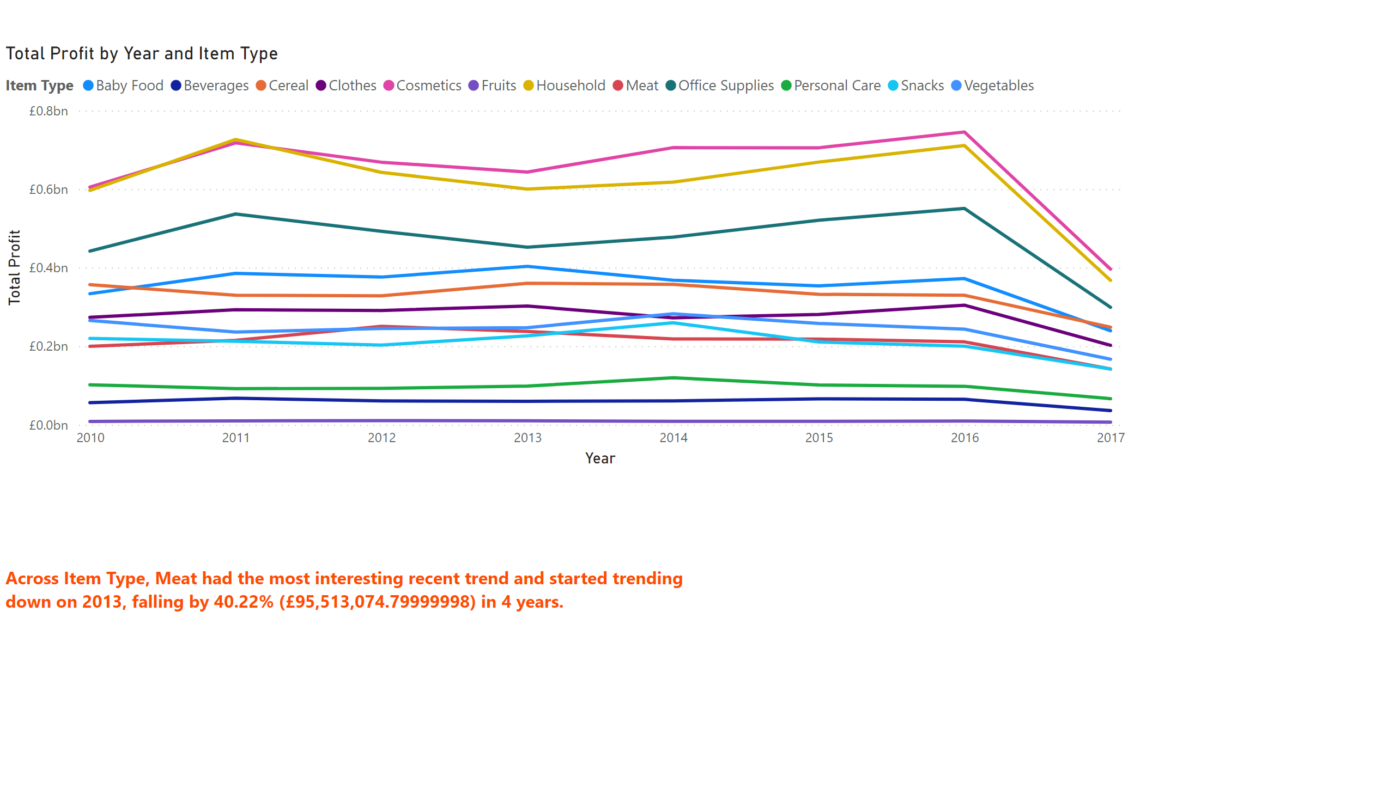
Item type profit per year
Notes:
lineChart
No alt text provided
textbox
No alt text provided

